Slide 1
Predict Likelihood of Completion for Future Lifestyle Medicine Program
Jennifer Sailor
Mentors: Ms. Olga Kozlova & Dr. Praveen Madiraju

Slide 2
Outline
Introduction
Related Work
Methods
Results
Discussion
Conclusion
References

Slide 3
Lifestyle Medicine (LM) 6 Pillars:
Whole & Plant-Based Nutrition
Increase
Fitness
Form & Maintain Relationships
Manage
Stress
Improve
Sleep
Avoid Risky Substances
90% of US annual healthcare dollars are spent in treatment of chronic diseases and their complications (17)
Obesity
BMI 25-40
Diabetes
Type 2
Heart Disease
Cancer
Stroke
Mental Health
Cognitive Function
Pain Mitigation
Notes:
LM focuses on prevention!
Focuses to prevent and reverse chronic diseases and noncommunicable diseases

Slide 4
Motivation & Goals
Research
Likelihood for self-selection and completion of programs
Data Set
Find a data set,
create simulated data, perform data cleaning and analysis.
Prediction Model
What psycho-demographics affect self-selection and completion?
Reduction in prevalence and incidence of chronic disease
Contact Business
to implement LM program as apart of there insurance
Results
predictions
Reduction in medical claim costs for employers and payers
Health benefits and improved life expectancy from improved well-being
Notes:
Blue is the goal during the REU
Green is the long term bigger picture of the project

Slide 5
Methods
Research
Likelihood for self-selection and completion of programs. Possible Psycho-demographics
Literature Review
Discussion with Experts

Slide 6
Literature Review
LM Programs Effectiveness
Psycho-demographics
Machine Learning
Treatment
Business Benefits
Majority will make lifestyle modification within 3 months (1)
Marital Status
Maintaining healthy relationships is a pillar of LM (1)
NLP
Used to extract data from health care records to figure if LM advice was given. (1)
The intervention group over 3 years saw improvements in Body Pains and QOL (9)
Cost Savings
Both in short (3 years) and long term (7)
Of the adult hypertensive population that received counseling, 88% reported adhering to those recommendations (4)
Giving Advice
96 percent of respondents made a Lifestyle modification (2)
Simulated Data
To predict long term cost saving effects of LM (7)
Pain Management
Physical disabilities, psychological, lifestyle/routine disruption (16)
a LM program for high-risk obese population at “best saved $8,046 per person per year and at worst did not increase health care costs” (8)
“At 12 weeks, 86.2% (94/109) of participants were still using the app” (6)
Social & Economical Constraints (3)
Random Forests
To look at heterogenous treatment effects (11)
Cancer
Avoiding tobacco and alcohol and maintain healthy BMI are effective in reducing cancer risk (15)
“we found that a person with diabetes costs about $10 000 more per year than someone without the condition”
(13)
The intervention LM group had fewer inpatient admissions (8)
Occupation & Income Level(10)
PTSD
Proper nutrition, increasing exercise, improving sleep, avoid risky substances, healthy relationships (18, 19, 20, 21)
Productivity
Intervention group saw improvements in mental health and work productivity. (10)
Notes:
Summarize!!!

Slide 7
Discussion with Experts
Dr. Kenneth Jacobsohn - Lifestyle Medicine Certified Urologist
LM is tailored to the patient and should be considered a prescription
When it comes to treatment, chronic diseases (PTSD, Cancer, OUD, …) will need to be treated first. Then LM can be used to prevent it from recuring again, aiding in recovery, or reversing any other health risk factors.
Nutrition is the strongest pillar of Lifestyle Medicine.
Robin Cook - Nutrition Health Coach
Most of her clientele fall under the category self selected. Typical reasons for enrolling in her program include the desire to feel better, prevent a chronic disease, or to take a holistic approach.
Stress impacts sleep, healing, and can trigger cravings.

Slide 8
Methods
Research
Likelihood for self-selection and completion of programs. Possible Psycho-demographics
Data Set
Find a data set,
perform data cleaning and analysis,
Literature Review
Descriptive Statistics
Discussion with Experts
Regression Analysis
Notes:
Explain the data set switch of goals

Slide 9
Results: Background
Deidentified dataset from a large Midwest health system
Database of individuals who participated in a health risk appraisal (HRA) program through there employers in year 1 and year 2
The outcome measure is the Personal Health Risk Score (PHRS), a range between 100 (best) to a negative integer.
Factors include total cholesterol, HDL, triglycerides, blood glucose, LDL, non LDL, blood pressure, waist circumference, BMI, and nicotine use
The optional intervention between year 1 and year 2 was participation in health coaching sessions which vary in length.

Slide 10
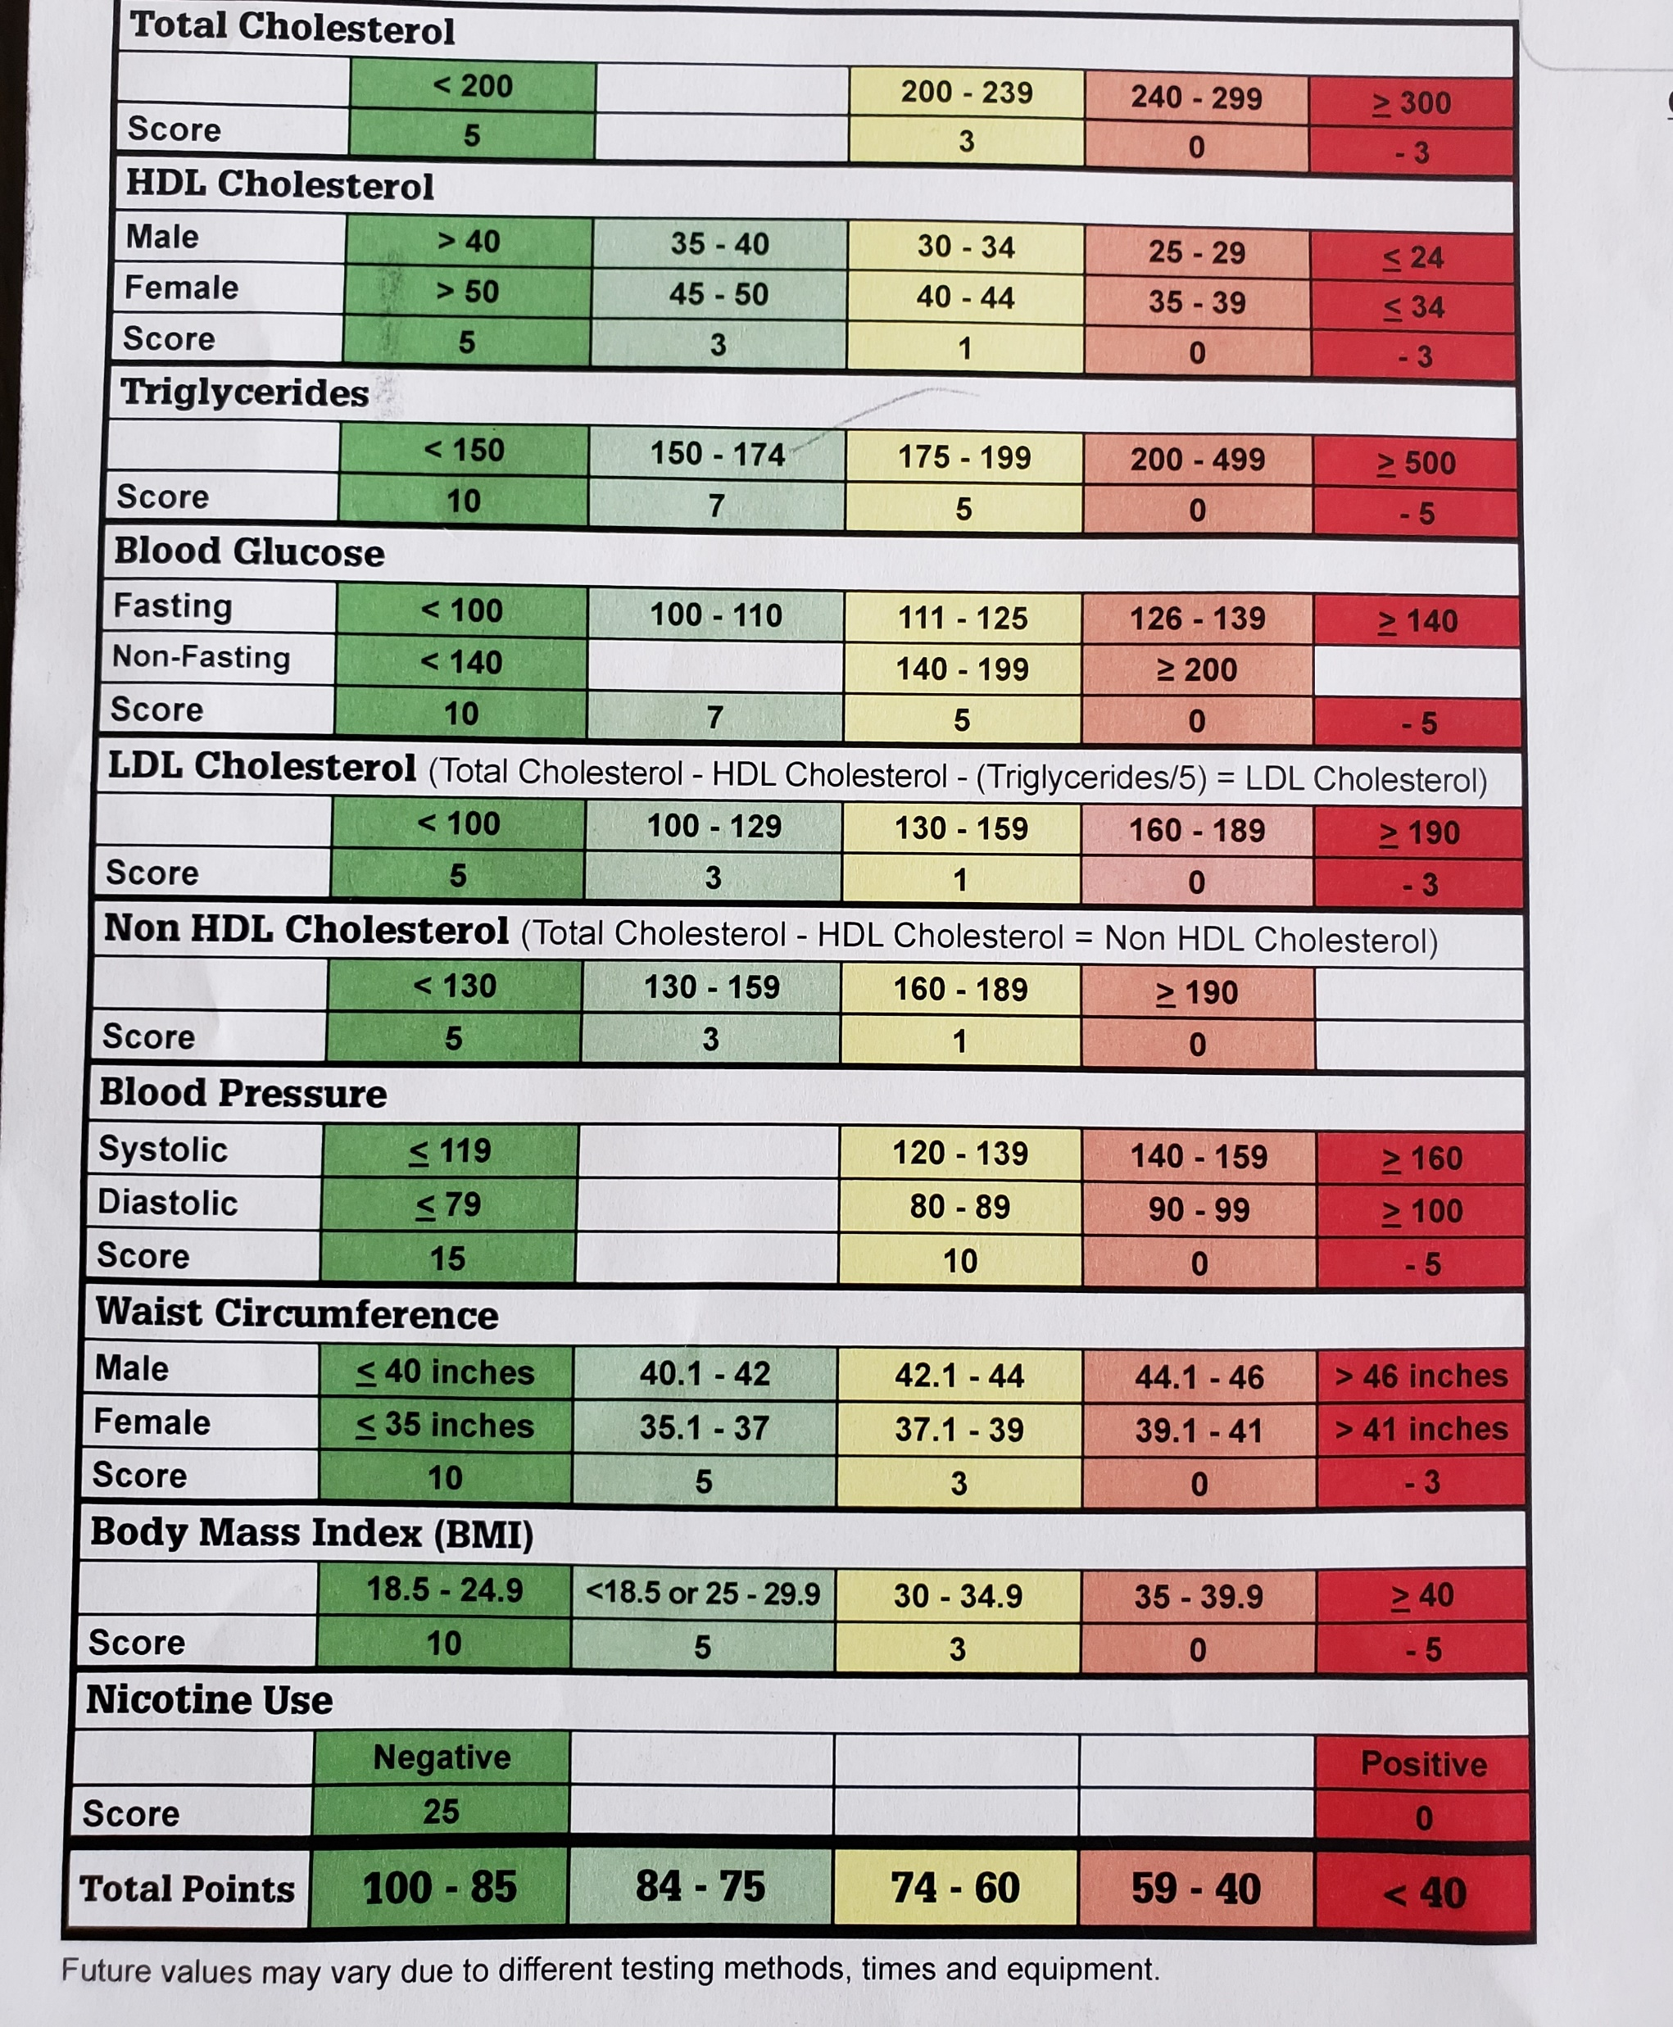
Results: Background
Gender | Percent that enrolled in coaching
Male | 6.27
Female | 7.72
Total | 13.99
BMI Category | Percent of Individuals
18.5-24.9 - healthy | 19.44
<18.5 or 25-29.9 - unhealthy or almost overweight | 32.86
30-34.9 - overweight | 25.05
35-39.9 - obese | 12.86
=>40 - chronically obese | 9.80
Notes:
Of the 9366 individuals, 14 percent enrolled in coaching: incentive? Were people already healthy?
Roughly 50 percent of the people were in the best two BMI categories

Slide 11
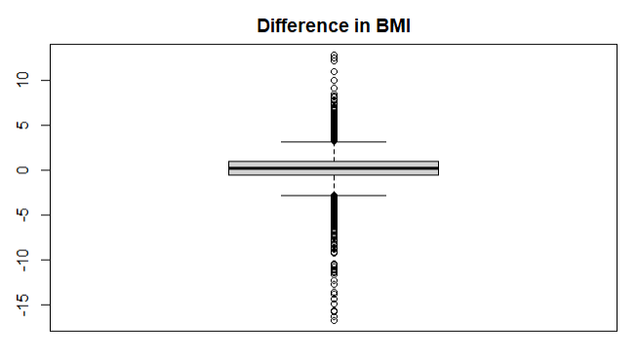
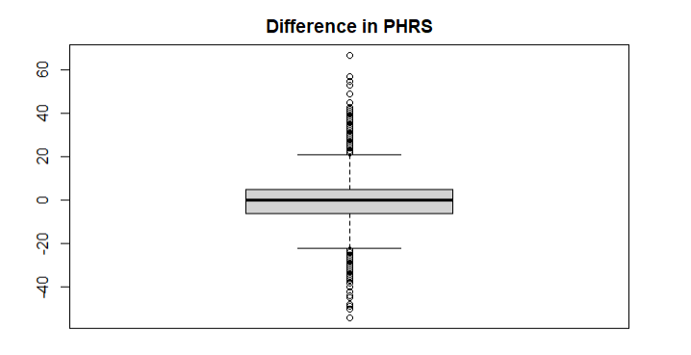
Results: Boxplots
Notes:
Outliers are not absurd: loosing a leg, pregnancy, treatment via surgery or medication

Slide 12
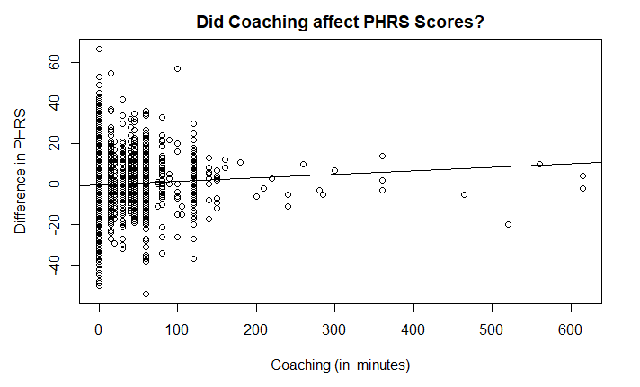
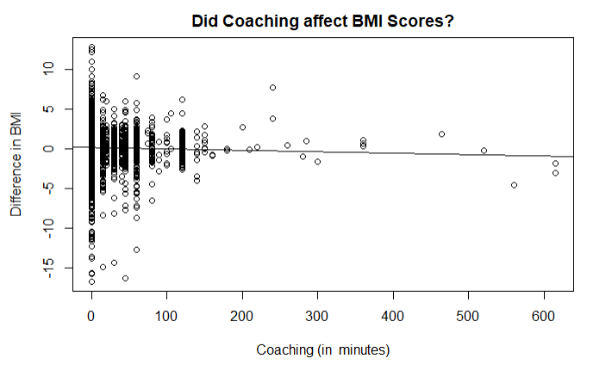
Results: Affects of Coaching
X= total amount of coaching in minutes
Y = difference in PHRS score (year 2 – year 1)
Slope = 0.017
X= total amount of coaching in minutes
Y = difference in BMI score (year 2 – year 1)
Slope = -0.0017
Notes:
PHRS: It was expected that as coaching in minutes increased there would be an increase in difference in PHRS scores (year 2 – year 1).
BMI: It was expected that as coaching in minutes increased there would be an decrease in difference in BMI scores (year 2 – year 1).
This graph means it is a bad investment for employers
a year is plenty of time to see change
Were there incentives in place

Slide 13
Results: Factors for Coaching
Does gender play a difference in the enrollment of health coaching?
Are there different trends based on BMI?
Percent that are Enrolled in Coaching Sessions
# of Sessions | Male (%) | Female (%)
1 | 30.83 | 30.15
2 | 22.99 | 19.79
3 | 29.98 | 34.16
4 | 13.97 | 9.54
>4 | 2.22 | 6.36
Percent of those that enrolled in coaching
that fall into a BMI category
BMI Category | Male (%) | Female (%)
18.5 – 24.9 | 8.46 | 9.19
< 18 or 25 – 29.9 | 9.37 | 11.5
30 – 34.9 | 12.6 | 18.2
35 – 39.9 | 19.5 | 22.2
>= 40 | 20.2 | 28.0
Percent = (Gender, BMI category, > 0 coaching) / (Gender, BMI category) * 100
Notes:
Session length vary
Would you do more sessions if you saw no change after
Incentives?
Good to screen for
Even if they enrolled in coaching does that mean they are willing to change

Slide 14
Discussion
Limitations:
Access to Data Set
Data Set Includes
2-year study
Gender and BMI are the only psycho-demographics
Time Restriction
Future Work:
Analyze a longitudinal study
Prediction Modeling
Original goal
predict likelihood of self-selection based on psycho-demographics

Slide 15
Conclusion
Does health coaching deliver results by improving the health of employees? Should employers pay for a health risk appraisal?
Between year 1 and year 2 evidence shows a lack of improvement in the health of employees.
Evidence does not support a health risk appraisal
Does gender play a role into self-selection health coaching?
Both genders have the same trends in enrollment into heath coaching
There shouldn’t be different approaches for men and women
What psycho-demographics aid in self-selection?
BMI: as the category of BMI worsens the percent enrolled in health coaching increases.

Slide 16
Citations (1/3)
(1) Shoenbill, K., Song, Y., Craven, M., Johnson, H., Smith, M., & Mendonca, E. A. (2020). Identifying patterns and predictors of lifestyle modification in electronic health record documentation using statistical and machine learning methods. Preventive medicine, 136, 106061.
(2) Viera, A. J., Kshirsagar, A. V., & Hinderliter, A. L. (2008). Lifestyle modifications to lower or control high blood pressure: is advice associated with action? The behavioral risk factor surveillance survey. The Journal of Clinical Hypertension, 10(2), 105-111.
(3) Vodovotz, Y., Barnard, N., Hu, F. B., Jakicic, J., Lianov, L., Loveland, D., ... & Parkinson, M. D. (2020). Prioritized Research for the Prevention, Treatment, and Reversal of Chronic Disease: Recommendations From the Lifestyle Medicine Research Summit. Frontiers in Medicine, 7, 959. veillance Survey. The Journal of Clinical Hypertension, 10(2), 105–111.
(4) Lopez, L., Cook, E. F., Horng, M. S., & Hicks, L. S. (2009). Lifestyle modification counseling for hypertensive patients: results from the National Health and Nutrition Examination Survey 1999–2004. American journal of hypertension, 22(3), 325-331.
(5) Berman, M. A., Appelbaum, K. J., Edwards, K. L., Eisenberg, D. M., & Katz, D. L. (2017). FareWell and the how of lifestyle medicine. American journal of lifestyle medicine, 11(4), 314-317.
(6) Berman, M. A., Guthrie, N. L., Edwards, K. L., Appelbaum, K. J., Njike, V. Y., Eisenberg, D. M., & Katz, D. L. (2018). Change in glycemic control with use of a digital therapeutic in adults with type 2 diabetes: cohort study. JMIR diabetes, 3(1), e9591.
(7) Saha, S., Carlsson, K. S., Gerdtham, U. G., Eriksson, M. K., Hagberg, L., Eliasson, M., & Johansson, P. (2013). Are lifestyle interventions in primary care cost-effective?–An analysis based on a Markov model, differences-in-differences approach and the Swedish Björknäs study. PloS one, 8(11), e80672.
(8) Wolf, A. M., Siadaty, M., Yaeger, B., Conaway, M. R., Crowther, J. Q., Nadler, J. L., & Bovbjerg, V. E. (2007). Effects of lifestyle intervention on health care costs: Improving Control with Activity and Nutrition (ICAN). Journal of the American Dietetic Association, 107(8), 1365-1373.

Slide 17
Citations (2/3)
(9) Eriksson, M. K., Hagberg, L., Lindholm, L., Malmgren-Olsson, E. B., Österlind, J., & Eliasson, M. (2010). Quality of life and cost-effectiveness of a 3-year trial of lifestyle intervention in primary health care. Archives of internal medicine, 170(16), 1470-1479.
(10) Agarwal, U., Mishra, S., Xu, J., Levin, S., Gonzales, J., & Barnard, N. D. (2015). A multicenter randomized controlled trial of a nutrition intervention program in a multiethnic adult population in the corporate setting reduces depression and anxiety and improves quality of life: the GEICO study. American Journal of Health Promotion, 29(4), 245-254.
(11) Baum, A., Scarpa, J., Bruzelius, E., Tamler, R., Basu, S., & Faghmous, J. (2017). Targeting weight loss interventions to reduce cardiovascular complications of type 2 diabetes: a machine learning-based post-hoc analysis of heterogeneous treatment effects in the Look AHEAD trial. The lancet Diabetes & endocrinology, 5(10), 808-815.
(12) Joiner, K. L., Nam, S., & Whittemore, R. (2017). Lifestyle interventions based on the diabetes prevention program delivered via eHealth: A systematic review and meta-analysis. Preventive medicine, 100, 194-207.
(13) Gulati, M., & Delaney, M. (2019). The lifestyle medicine physician’s case to self-insured employers: a business model for physicians, a bargain for companies. American journal of lifestyle medicine, 13(5), 462-469.
(14) Gray, I. D., Kross, A. R., Renfrew, M. E., & Wood, P. (2020). Precision Medicine in Lifestyle Medicine: The Way of the Future?. American journal of lifestyle medicine, 14(2), 169-186.
(15) American Cancer Society. Cancer Prevention and Early Detection. (n.d.). https://www.cancer.org/content/dam/cancer-org/research/cancer-facts-and-statistics/cancer-prevention-and-early-detection-facts-and-figures/2021-cancer-prevention-and-early-detection.pdf
(16) Simon, A. U., & Collins, C. E. (2017). Lifestyle Redesign® for chronic pain management: A retrospective clinical efficacy study. American Journal of Occupational Therapy, 71(4), 7104190040p1-7104190040p7.

Slide 18
Citations (3/3)
(17) American College of Lifestyle Medicine. Lifestyle Medicine. (n.d.). https://lifestylemedicine.org/What-is-Lifestyle-Medicine.
(18) Shivakumar, G., Anderson, E. H., Surís, A. M., & North, C. S. (2017). Exercise for PTSD in women veterans: A proof-of-concept study. Military medicine, 182(11-12), e1809-e1814.
(19) Martindale, S. L., Morissette, S. B., Rowland, J. A., & Dolan, S. L. (2017). Sleep quality affects cognitive functioning in returning combat veterans beyond combat exposure, PTSD, and mild TBI history. Neuropsychology, 31(1), 93.
(20) Lehavot, K., Stappenbeck, C. A., Luterek, J. A., Kaysen, D., & Simpson, T. L. (2014). Gender differences in relationships among PTSD severity, drinking motives, and alcohol use in a comorbid alcohol dependence and PTSD sample. Psychology of Addictive Behaviors, 28(1), 42.
(21) Freedman, S. A., Gilad, M., Ankri, Y., Roziner, I., & Shalev, A. Y. (2015). Social relationship satisfaction and PTSD: which is the chicken and which is the egg?. European Journal of Psychotraumatology, 6(1), 28864.

